Slide 1
App Inventor 2
@ai2.appinventor.mit.edu

Slide 2
Android, Where’s My Car?
http://explore.appinventor.mit.edu/ai2/android-wheres-my-car
Park the car, then click the button, the Android uses its location sensor to record the car's GPS coordinates and address
When you reopen the app later on, it shows you a map with directions from where your current location to the remembered address

Slide 4
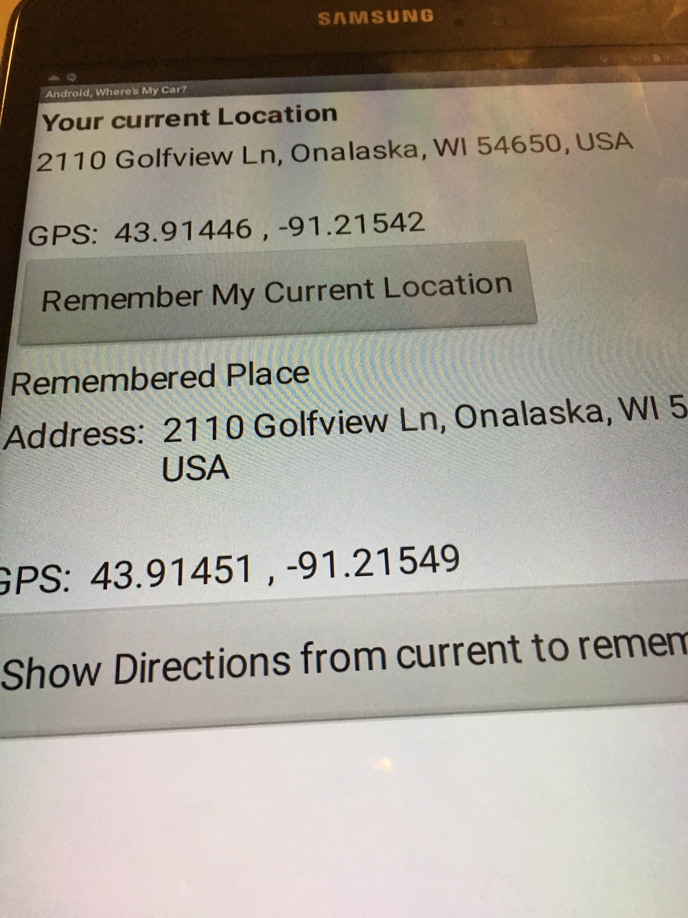

Slide 5
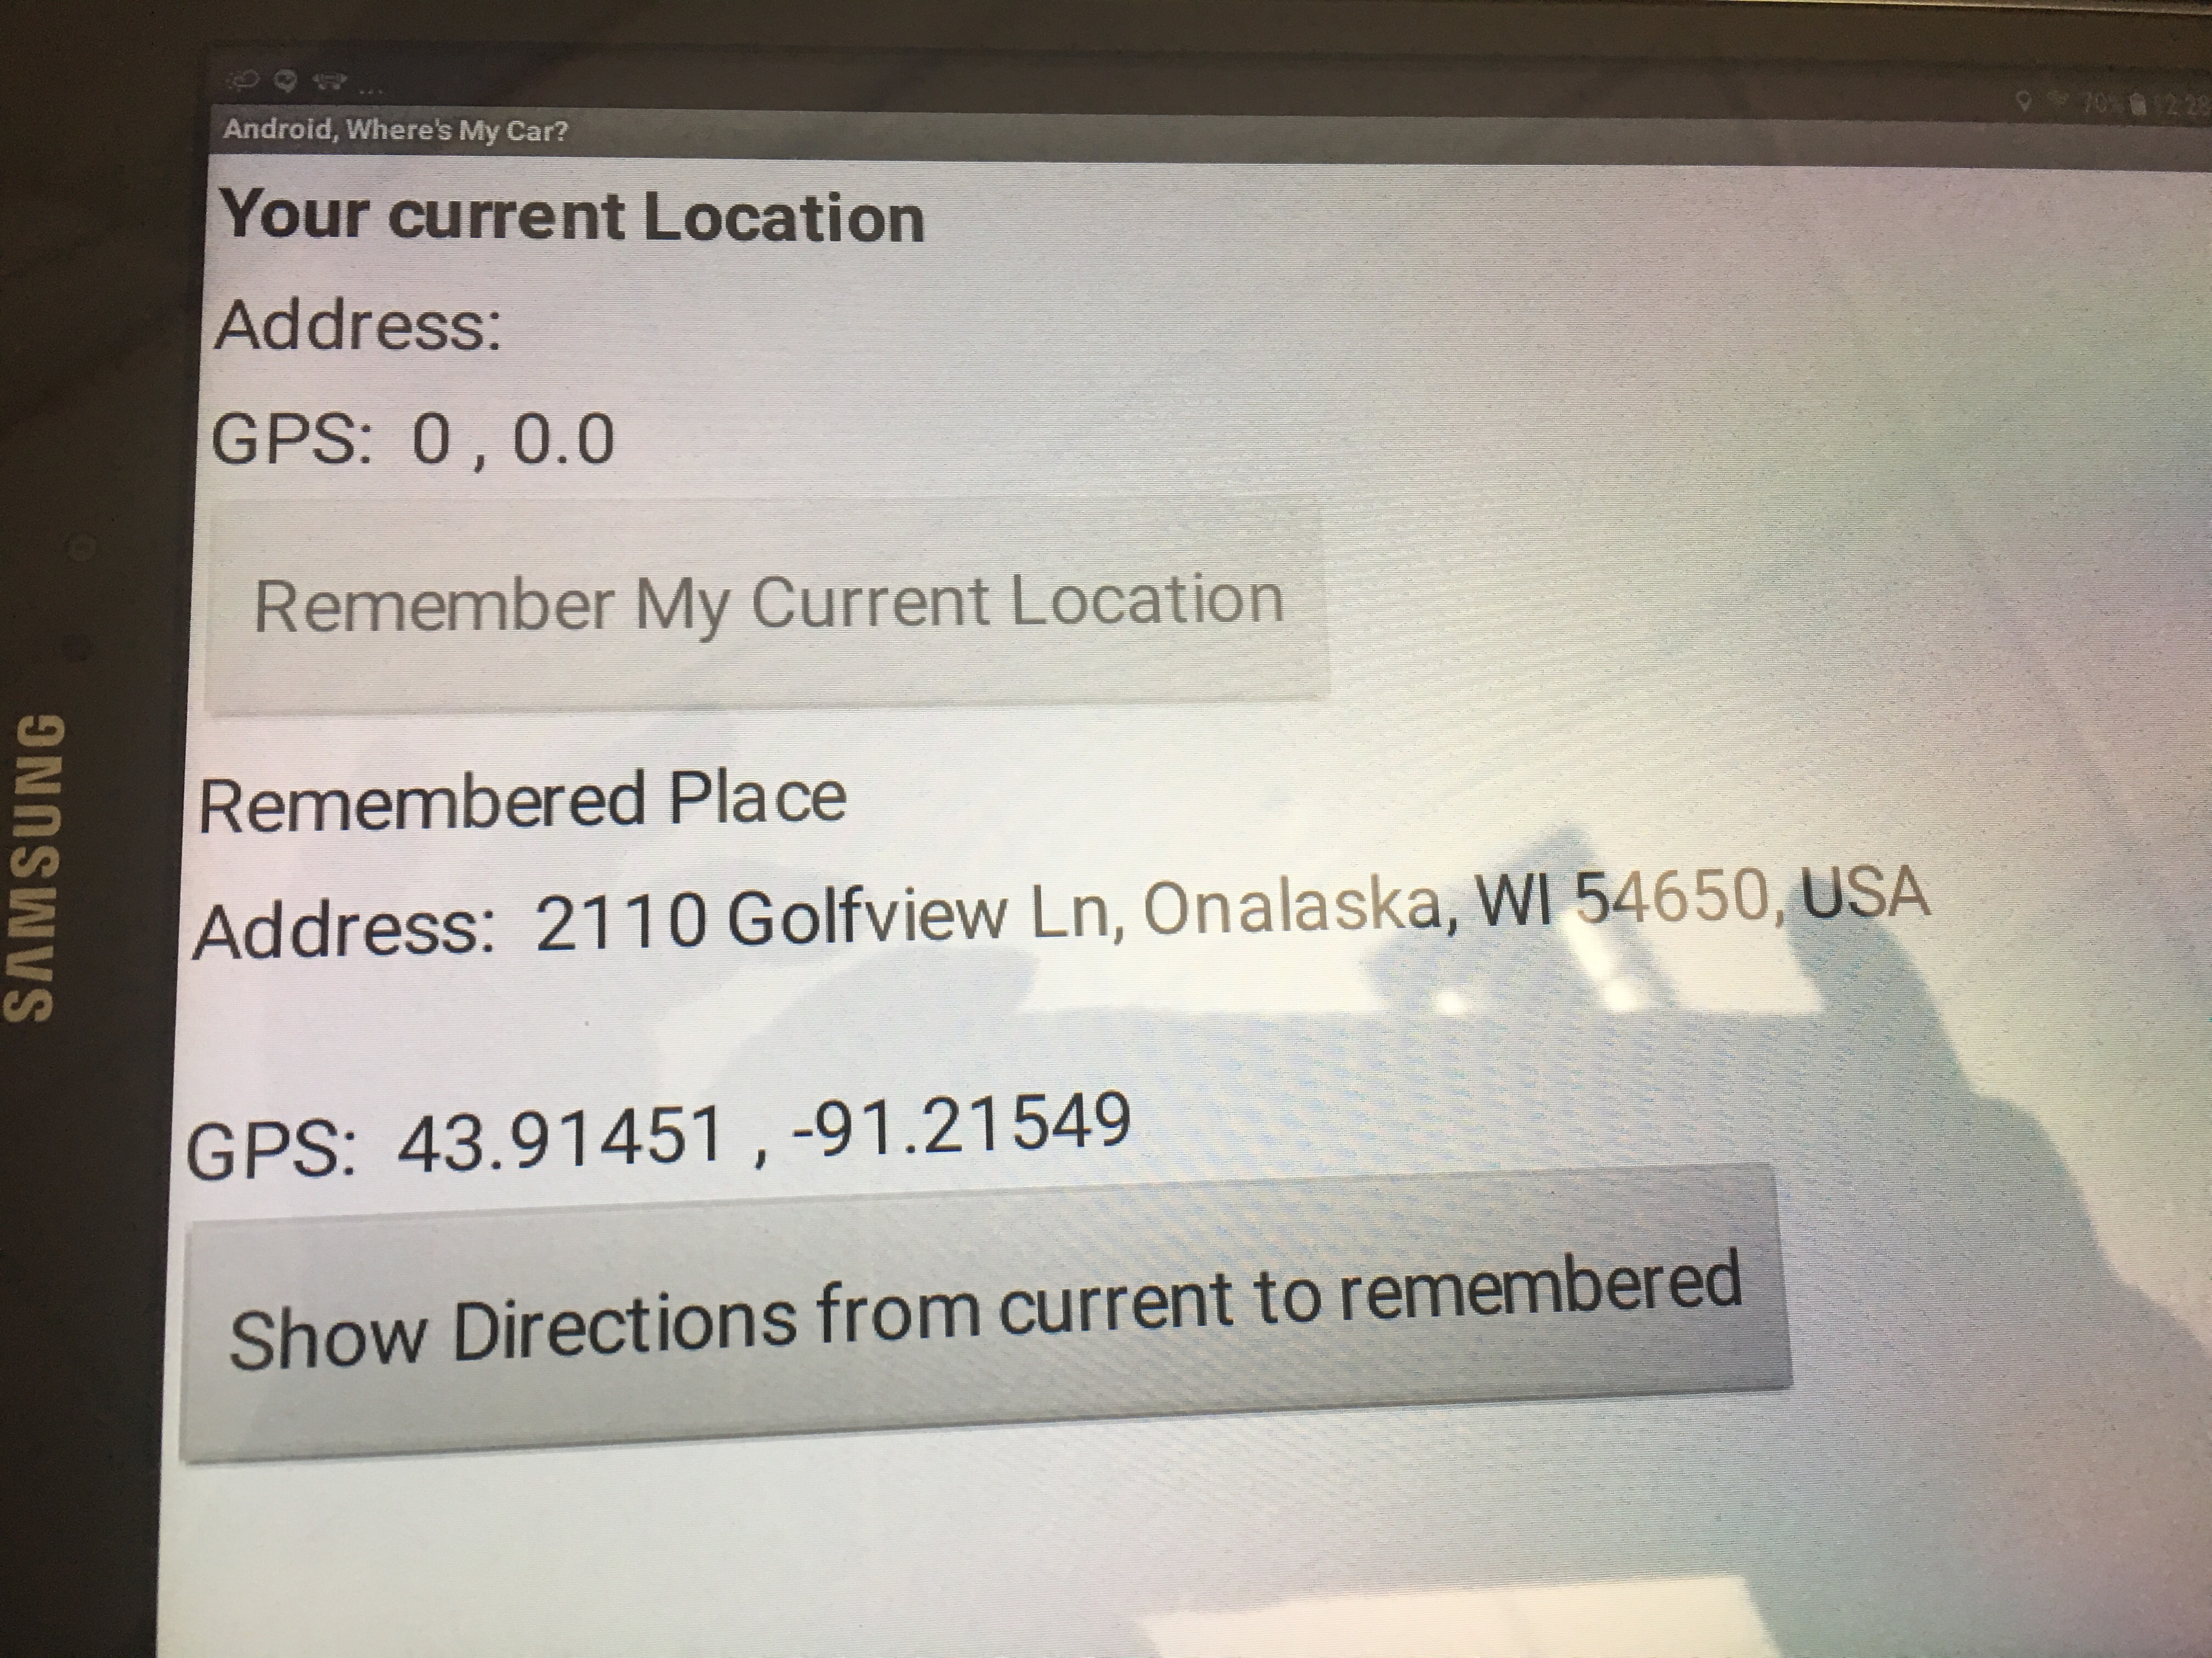

Slide 6
Designer

Slide 7
Layout
Change to be descriptive
And meaningful name

Slide 8
ActivityStarter

Slide 9
LocatonSenor1.LocationChanged

Slide 10
RememberButton.Click

Slide 11
DirectionButton.Click
http://maps.google.com/maps/?saddr=0.1,0.1&daddr=0.2,0.2

Slide 12
Screen.Initialize

Slide 13
WebView Javascript Processor
http://explore.appinventor.mit.edu/ai2/webview-javascript
Using the WebViewer component as a javascript processor
an HTML file that includes javascript that can reverse text
App sends the input text to the HTML file, it reverse the text, then sends back to the App

Slide 14
Upload Javascript file

Slide 17
Screen1.Initialize

Slide 18
bthProcess.Click

Slide 19
Clock1.Timer

Slide 20
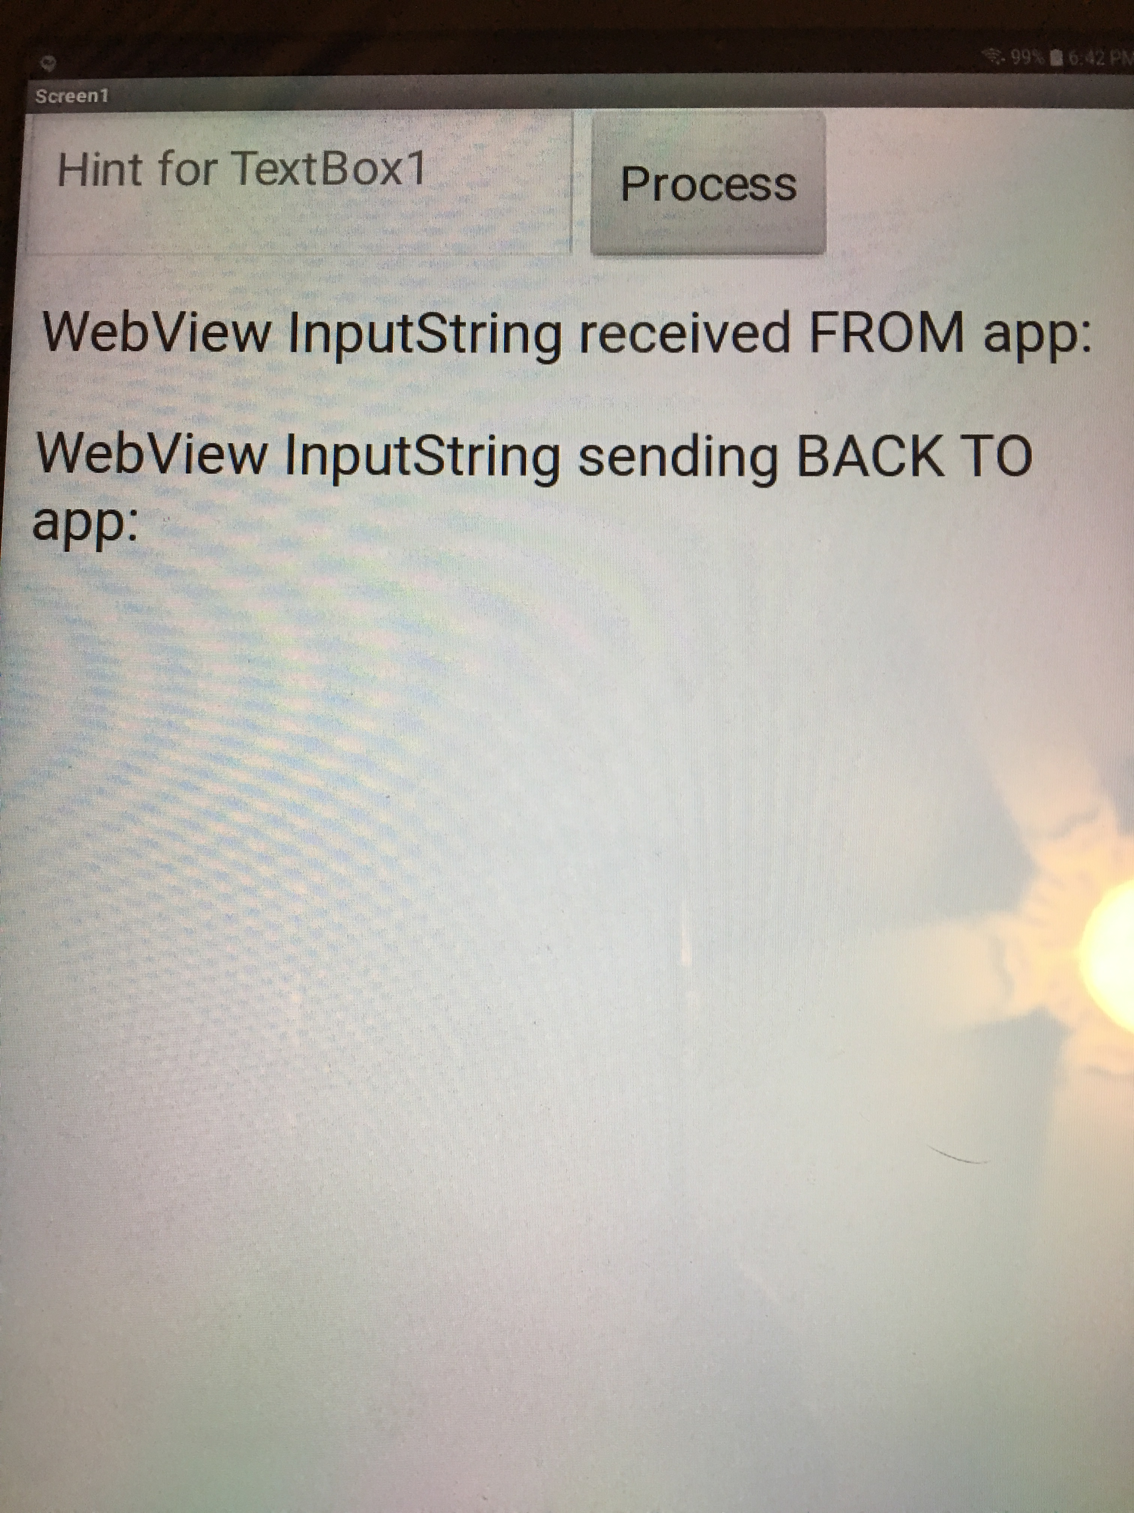

Slide 21
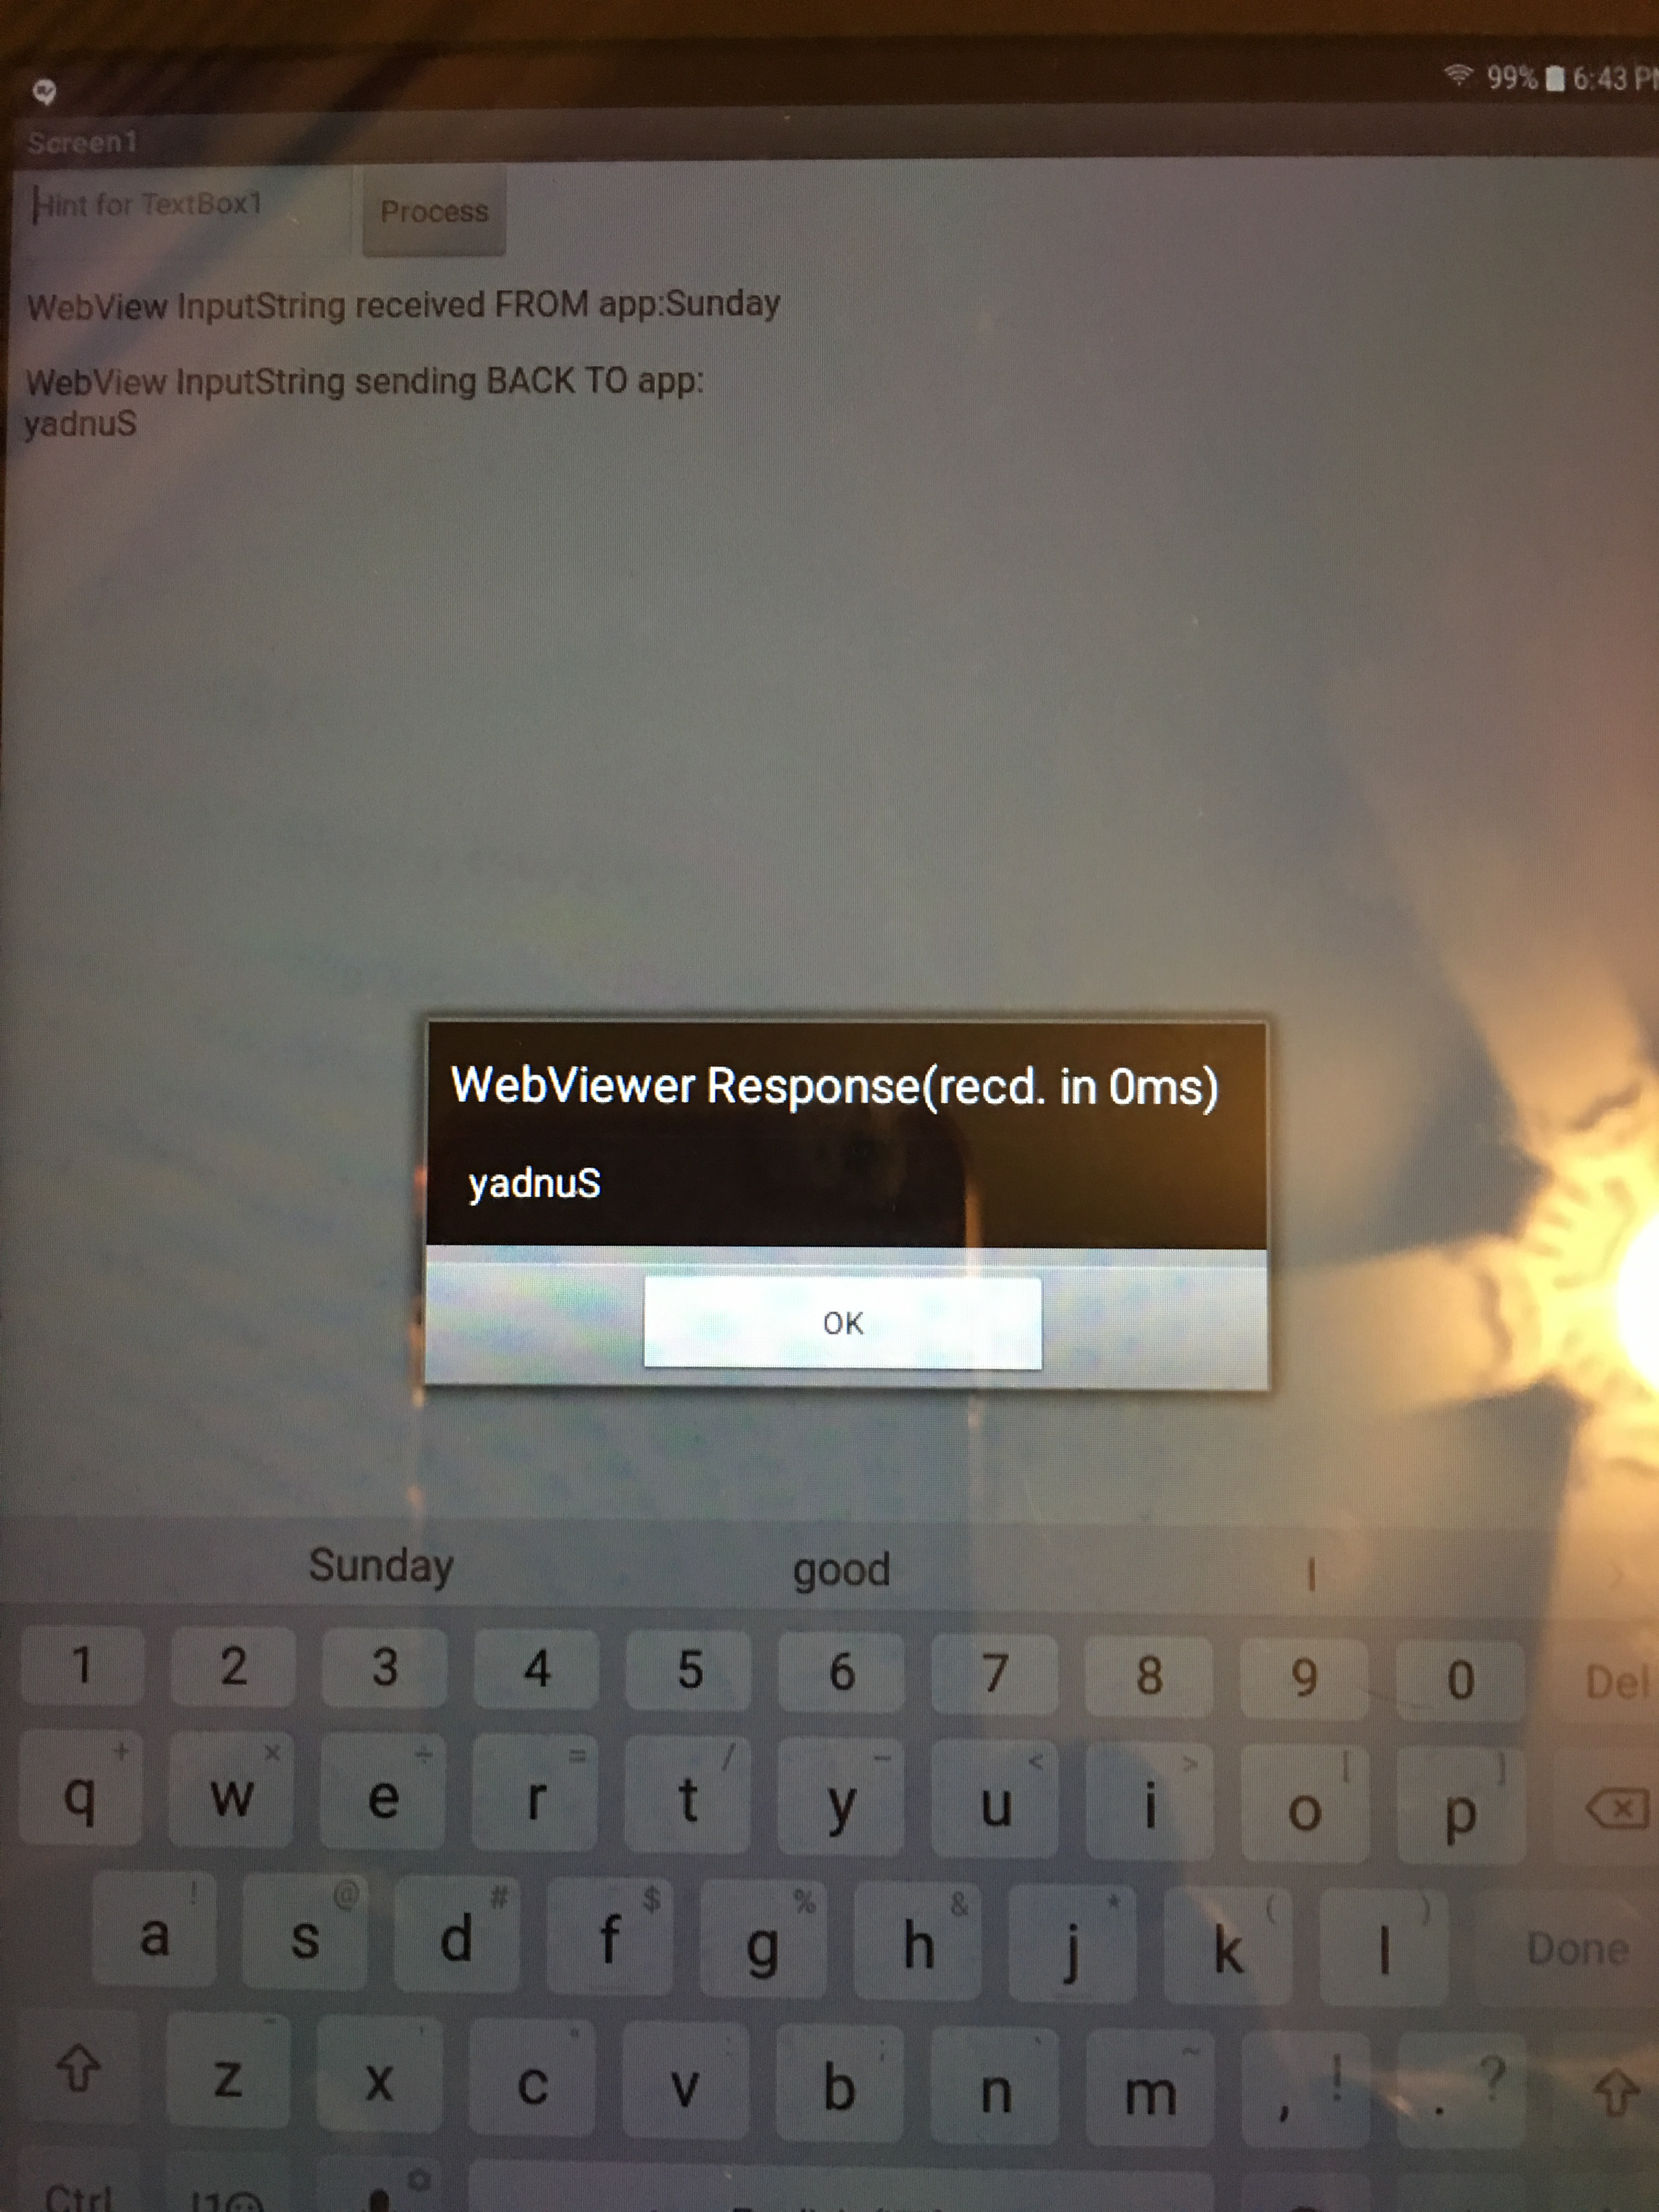

Slide 22
